Slide 1
Chapter 10 Organohalides

Slide 2
Learning Objectives
(10.1)
Names and structures of alkyl halides
(10.2)
Preparing alkylhalides from alkanes: Radical halogenation
(10.3)
Preparing alkyl halides from alkenes: Allylic bromination
(10.4)
Stability of the allyl radical: Resonance revisited

Slide 3
Learning Objectives
(10.5)
Preparing alkyl halides from alcohols
(10.6)
Reactions of alkyl halides: Grignard reagents
(10.7)
Organometallic coupling reactions
(10.8)
Oxidation and reduction in organic chemistry

Slide 4
Organohalides and Alkyl Halides
Organohalide is an organic compound containing at least one or more halogen atoms
Found in abundance in nature
Used as a solvent, inhaled anesthetic, and fumigant
Alkyl halides comprise a halogen atom bonded to a saturated, sp³-hybridized carbon atom

Slide 5
Names and Structures of Alkyl Halides
Alkenes with a halogen substitute are termed haloalkanes
Halogen is considered a substituent on the parent alkane chain
Naming alkyl halides:
Step 1 - Longest chain is named the parent
Contains double or triple bond if present
Notes:
Names and structures of alkyl halides

Slide 6
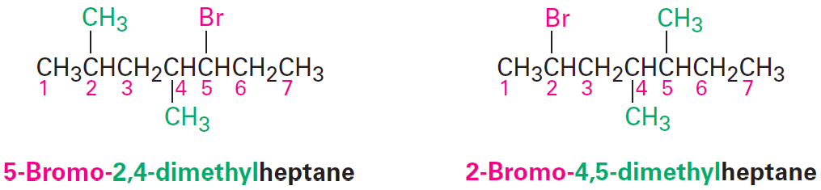
Names and Structures of Alkyl Halides
Step 2 - Carbons of the parent chain are numbered beginning at the end closer to the first substituent
Notes:
Names and structures of alkyl halides

Slide 7
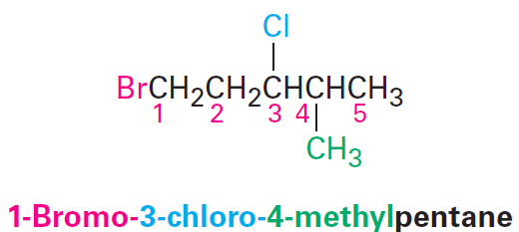
Names and Structures of Alkyl Halides
When more than one halogen is present, each are numbered and listed in alphabetical order when writing the name
Notes:
Names and structures of alkyl halides

Slide 8
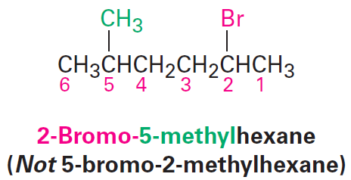
Names and Structures of Alkyl Halides
Step 3 - If the parent chain can be properly numbered from either end by step 2, numbering begins at the end closer to the substituent that has alphabetical precedence
Notes:
Names and structures of alkyl halides

Slide 9
Names and Structures of Alkyl Halides
Apart from the systematic naming convention, identification of the first alkyl group and then the halogen provides the names of many alkyl halides
CH₃I is called iodomethane or methyl iodide
Notes:
Names and structures of alkyl halides

Slide 10
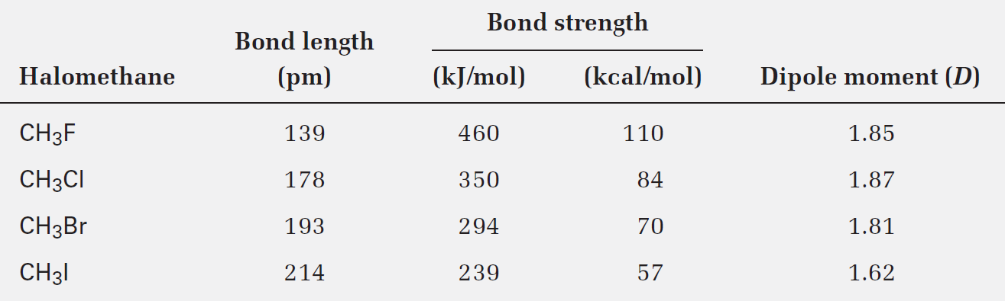
Comparison of the Halomethanes
With progression down the periodic table:
Size of halogens increase
C–X bond lengths increase
C–X bond strengths decrease
Notes:
Names and structures of alkyl halides

Slide 11
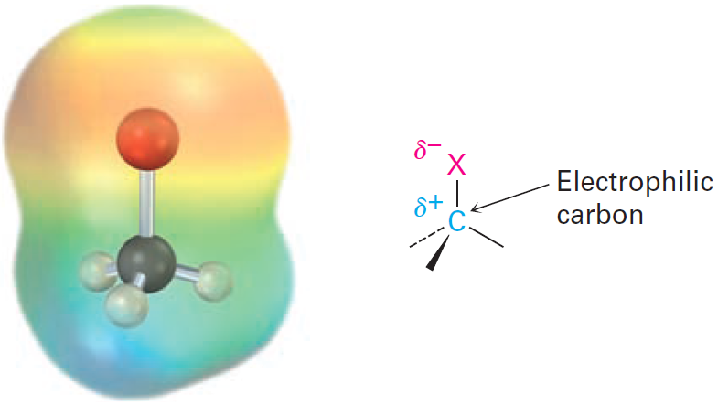
Polarity of C─X Bonds
Halomethanes possess a substantial dipole moment
Slight positive charge (δ+) on carbon atoms
Slight negative charge (δ-) on halogens
C─X carbon atom is considered to behave as an electrophile in polar reactions
Notes:
Names and structures of alkyl halides

Slide 12
Worked Example
Provide the IUPAC name of the following alkyl halide:
CH₃CH₂CH₂CH₂I
Solution:
1-Iodobutane
Halogens are treated the same as alkyl substituents but are named as a halo group
Notes:
Names and structures of alkyl halides

Slide 13
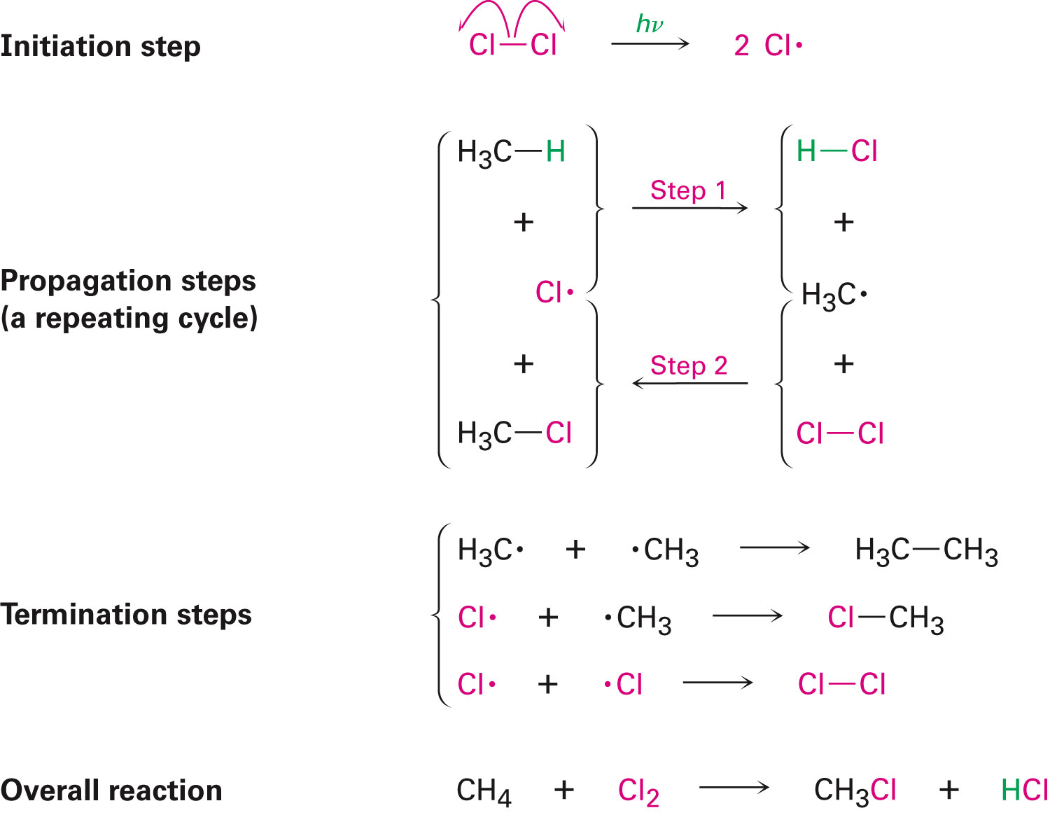
Preparing Alkyl Halides from Alkenes: Radical Halogenation
Alkanes react with Cl₂ or Br₂ in the presence of light through a radical chain-reaction pathway, producing simple alkyl halides
Notes:
Preparing alkyl halides from alkenes: Radical halogenation

Slide 14
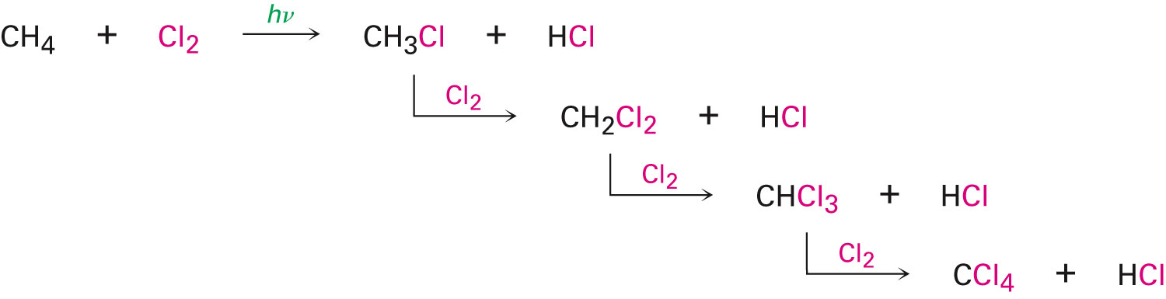
Preparing Alkyl Halides from Alkenes: Radical Halogenation
Requirements of a radical substitution reaction
Initiation, propagation, and termination
Preparation of alkyl halides by alkane halogenation results in mixtures of compounds
Notes:
Preparing alkyl halides from alkenes: Radical halogenation

Slide 15
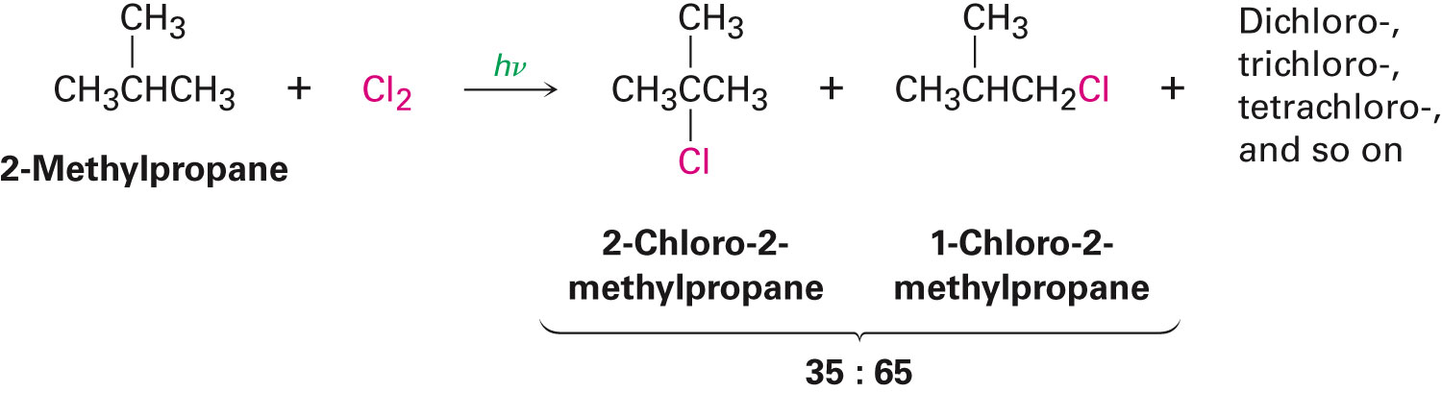
Radical Halogenation of Alkanes
Complications are more in cases of alkanes that have more than one kind of hydrogen
A reactivity order can be calculated toward chlorination for different kinds of hydrogen atoms
Notes:
Preparing alkyl halides from alkenes: Radical halogenation

Slide 16
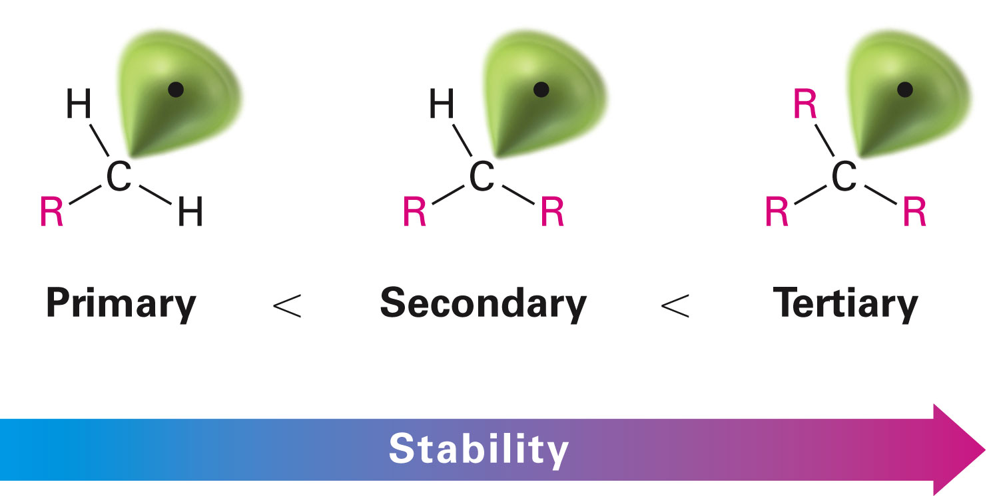
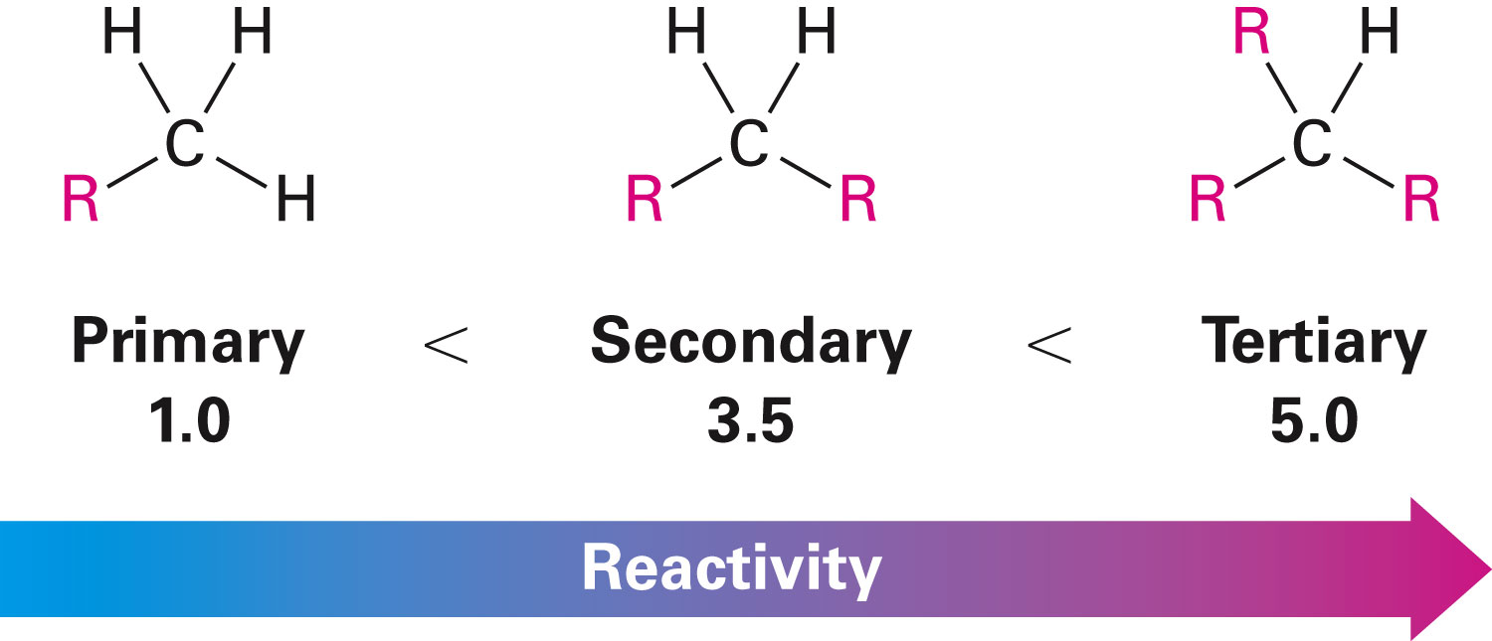
Radical Halogenation of Alkanes
Based on quantitative analysis of reaction products, relative reactivity is estimated
With reference to energy required to break C–H bonds, resultant tertiary radicals are more stable than primary or secondary radicals
Notes:
Preparing alkyl halides from alkenes: Radical halogenation

Slide 17
Worked Example
Draw and name all monochloro products that can be obtained from radical chlorination of 2-methylpentane
Identify chiral products if present
Notes:
Preparing alkyl halides from alkenes: Radical halogenation

Slide 18
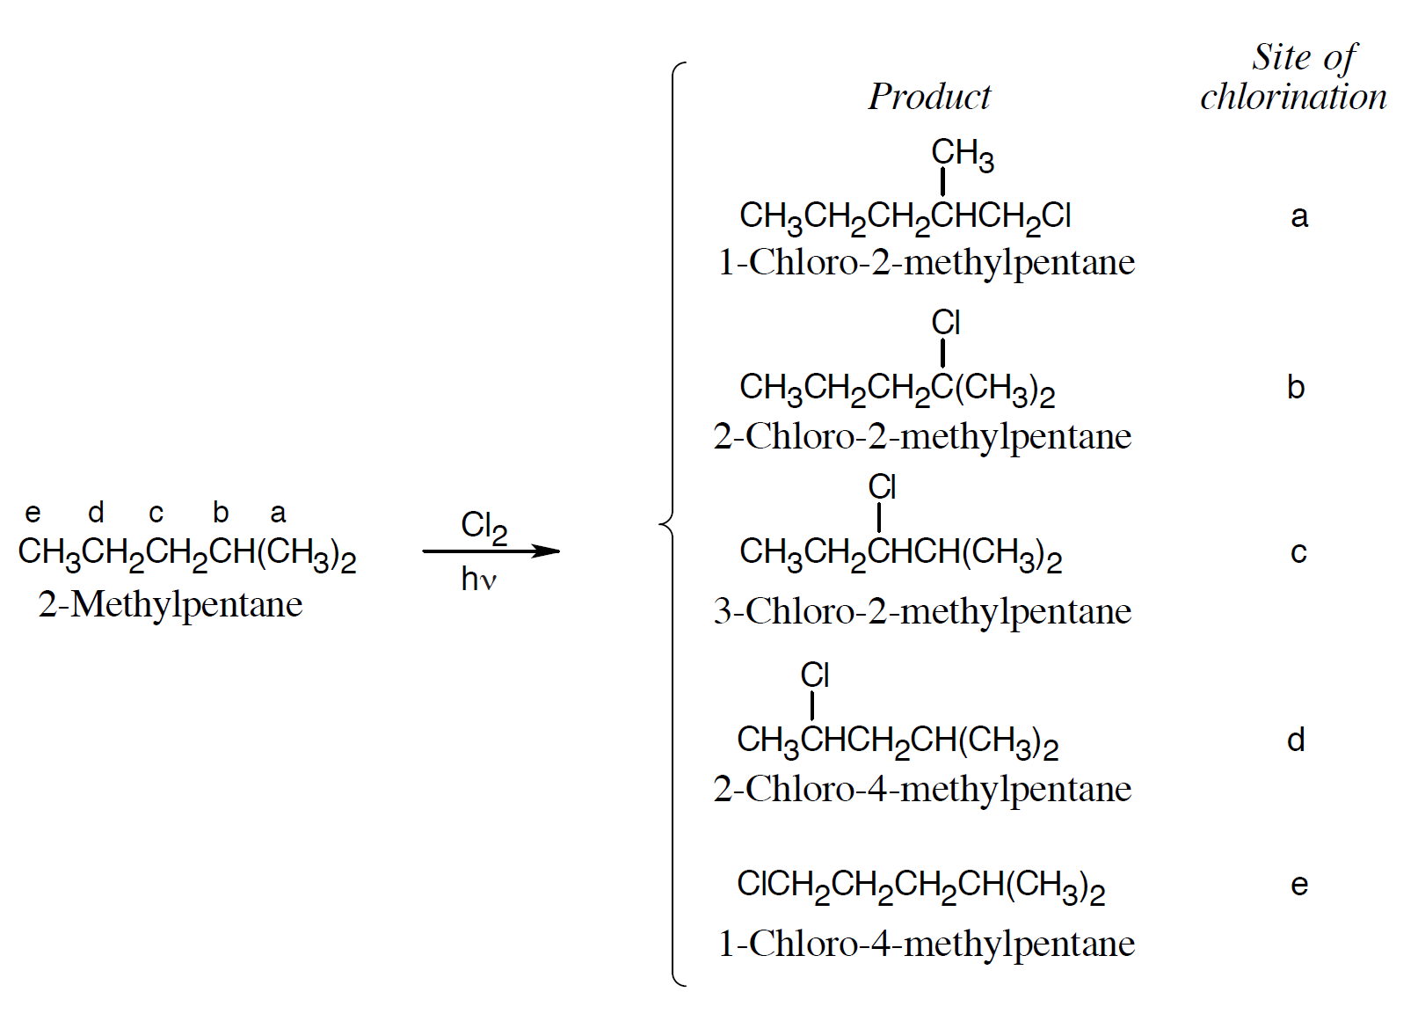
Worked Example
Solution:
Products at sites a, c, and e are chiral
Notes:
Preparing alkyl halides from alkenes: Radical halogenation

Slide 19
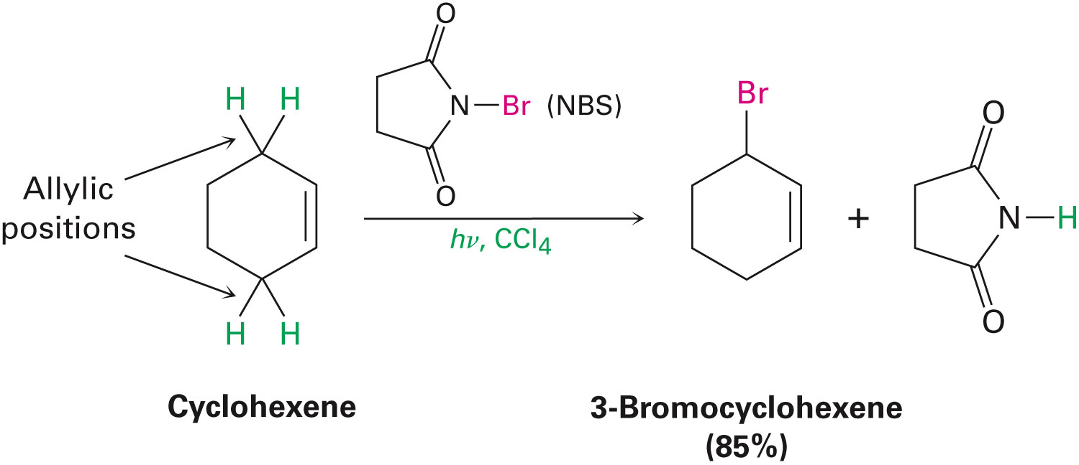
Preparing Alkyl Halides from Alkenes: Allylic Bromination
Alkenes react with N-bromosuccinimide (NBS) in the presence of light to produce alkyl halides
Hydrogen is substituted by bromine at the allylic position
Notes:
Preparing alkyl halides from alkenes: Allylic bromination

Slide 20
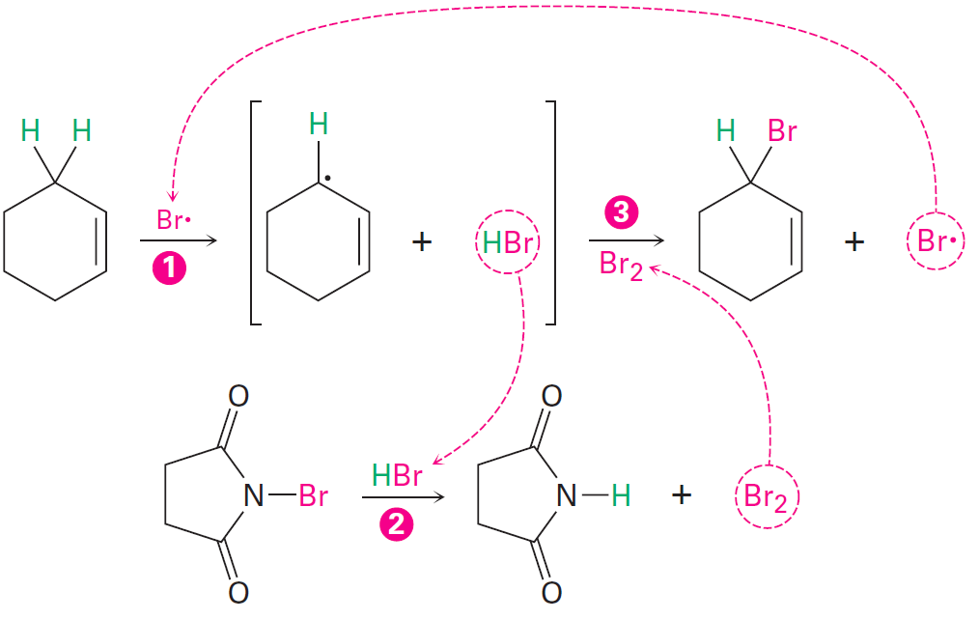
Figure 10.2 - Mechanism of Allylic Bromination of an Alkene with NBS
Notes:
Preparing alkyl halides from alkenes: Allylic bromination

Slide 21
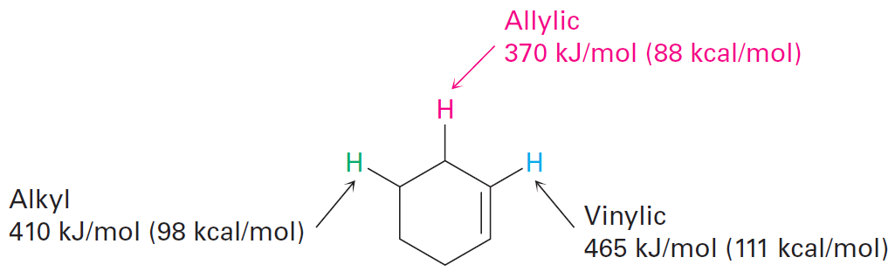
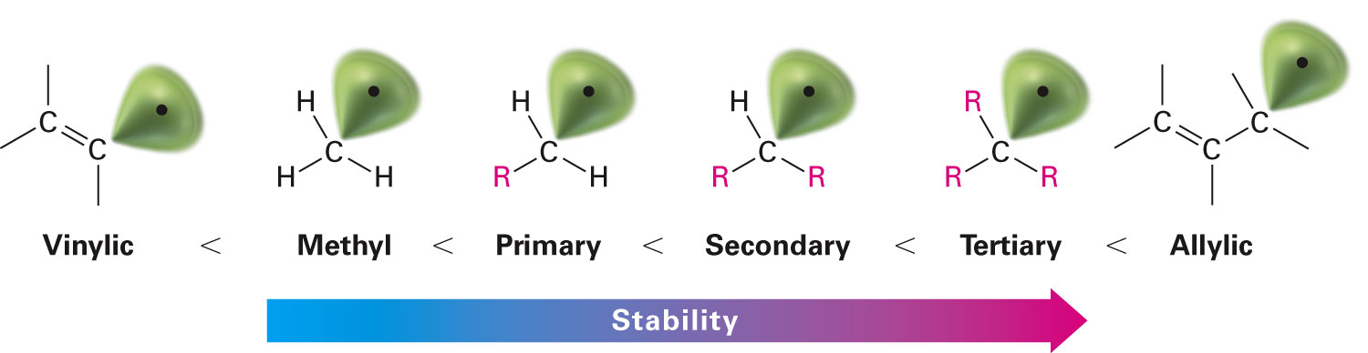
Relation Between Bromination and Bond Dissociation Energies
Bond dissociation energies help determine the relative stabilities of various kinds of radicals
Notes:
Preparing alkyl halides from alkenes: Allylic bromination

Slide 22
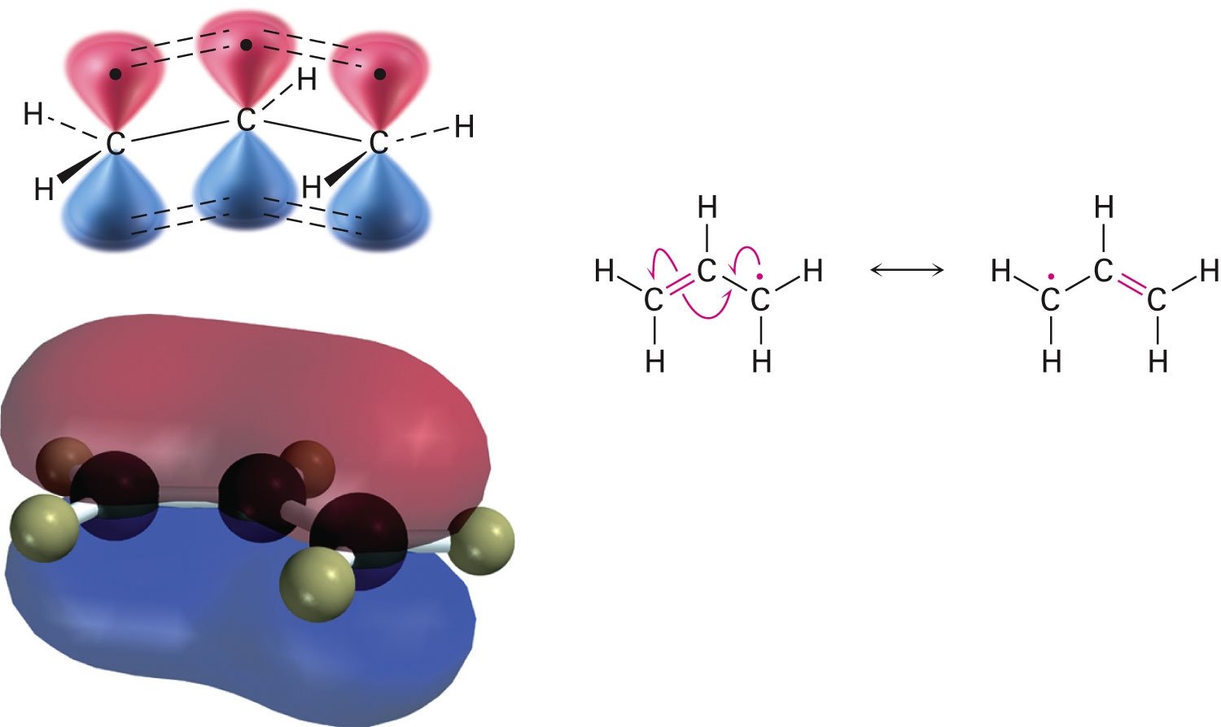
Stability of the Allyl Radical: Resonance Revisited
Radical carbon atom adopts sp²-hybridization
Structure is electronically symmetrical
p orbital on the central carbon overlaps equally with p orbitals on neighboring carbons
Notes:
Stability of the allyl radical: Resonance revisited

Slide 23
Stability of the Allyl Radical: Resonance Revisited
Electronic symmetry of the allyl radical is the reason it possesses two resonance forms
High number of resonance forms result in increased stability of the compound
Bonding electrons are attracted to more nuclei
According to molecular orbital terms, stability of an allyl radical is because the unpaired electron is delocalized rather than localized at one site
Delocalization causes allyl radicals to react with Br_{2,} producing a mixture of products
Notes:
Stability of the allyl radical: Resonance revisited

Slide 24
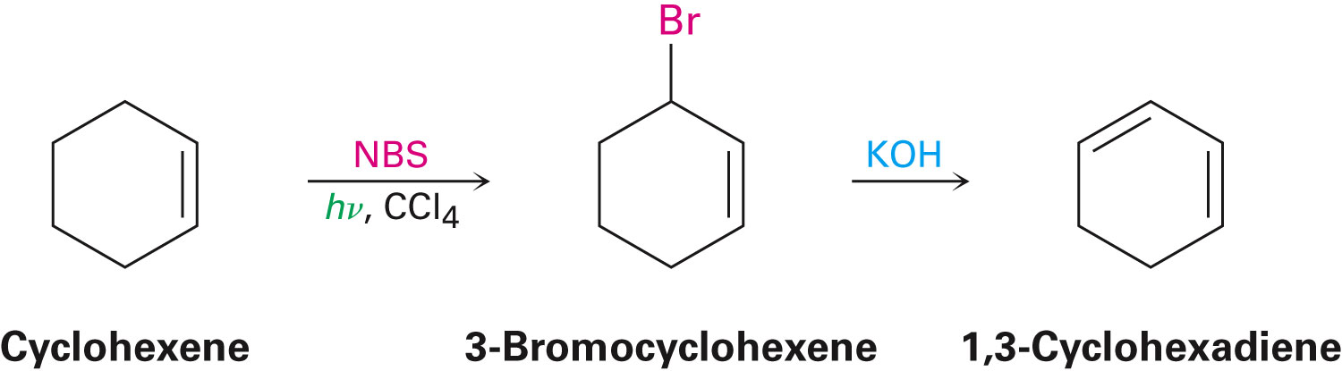
Stability of the Allyl Radical: Resonance Revisited
Allylic bromination products are converted into dienes by dehydrohalogenation with a base
Notes:
Stability of the allyl radical: Resonance revisited

Slide 25
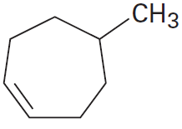
Worked Example
Mention the products formed when the following alkene reacts with NBS
Show the structures of all products formed
Notes:
Stability of the Allyl Radical: Resonance Revisited

Slide 26
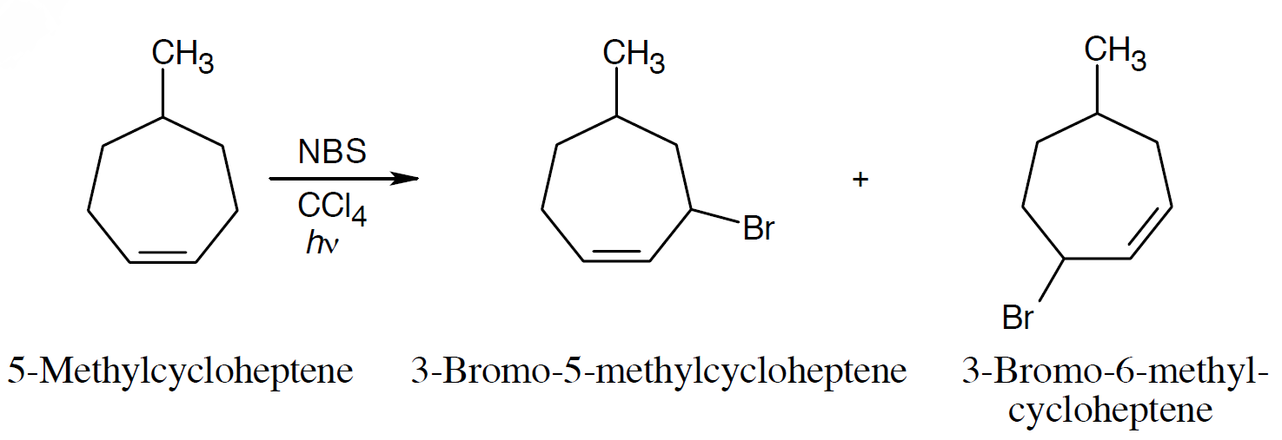
Worked Example
Solution:
Notes:
Stability of the allyl radical: Resonance revisited

Slide 27
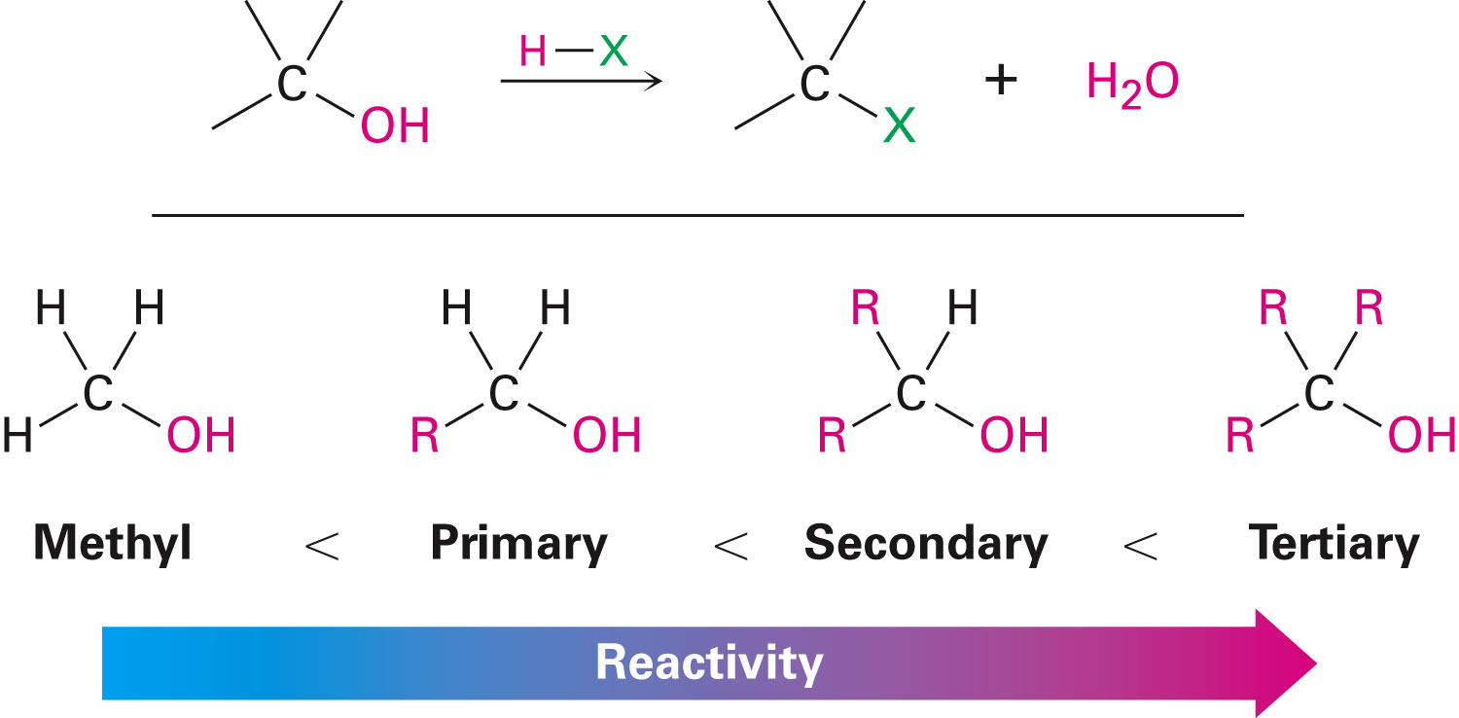
Preparing Alkyl Halides from Alcohols
Treating alcohol with HCl, HBr, or HI is the simplest method of deriving alkyl halides
Rate of reaction in primary and secondary alcohols is slower and occurs at higher temperatures
Notes:
Preparing alkyl halides from alcohols

Slide 28
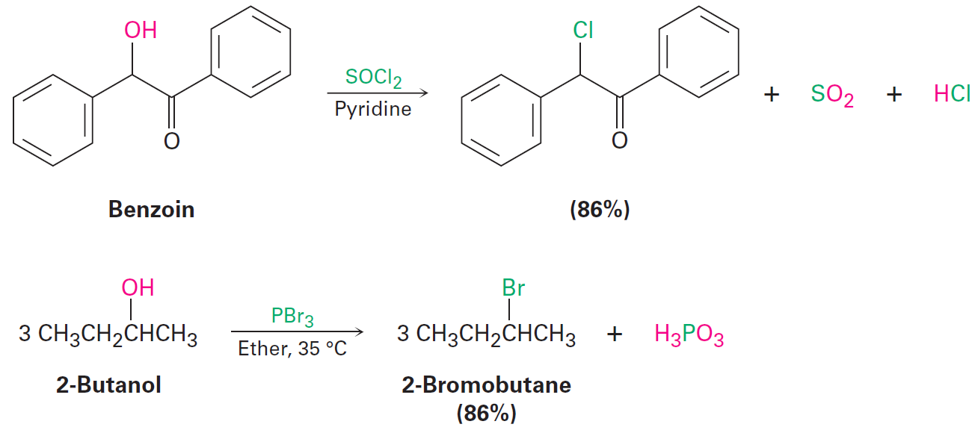
Preparing Alkyl Halides from Alcohols
Optimal conversion of primary or secondary alcohols into halides is possible by treatment with thionyl chloride or phosphorus tribromide
Notes:
Preparing alkyl halides from alcohols

Slide 29
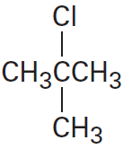
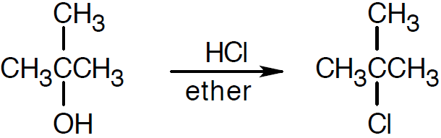
Worked Example
Prepare the following alkyl halide from the corresponding alcohol
Solution:
Notes:
Preparing alkyl halides from alcohols

Slide 30
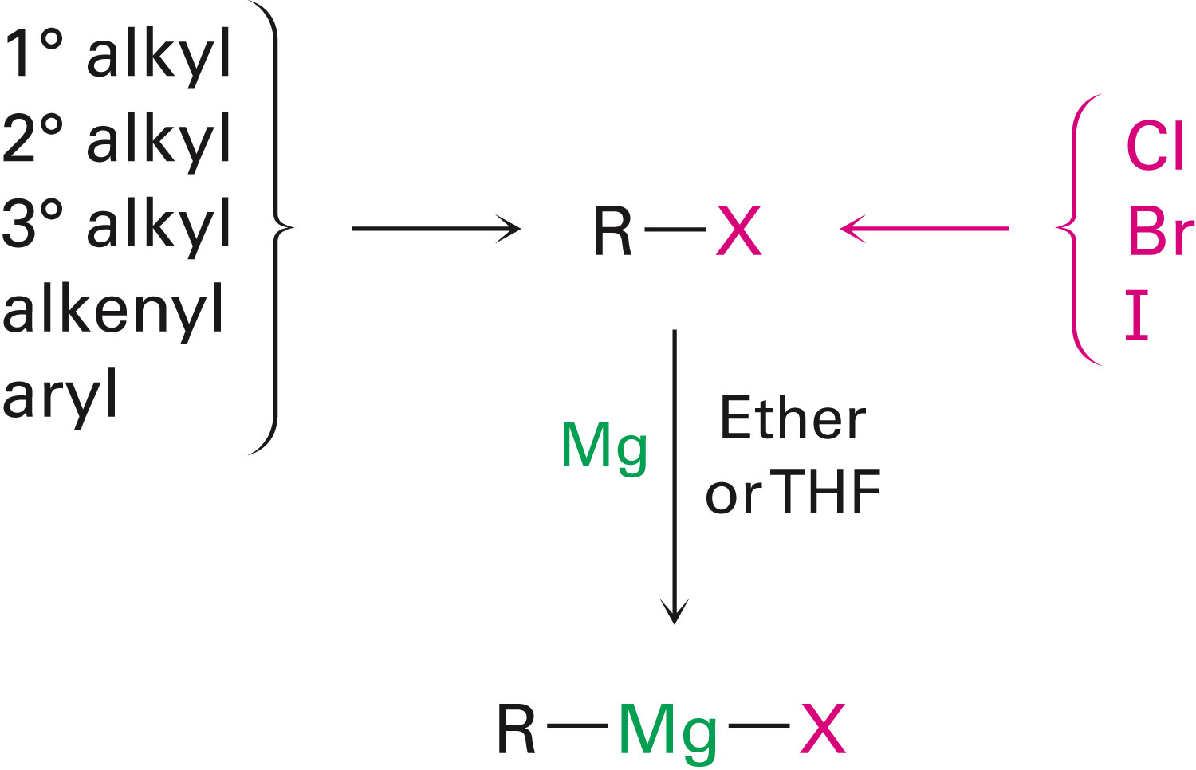
Reactions of Alkyl Halides: Grignard Reagents
Reaction of RX with Mg in ether or THF, produces Grignard reagents (RMgX)
Notes:
Reactions of alkyl halides: Grignard reagents

Slide 31
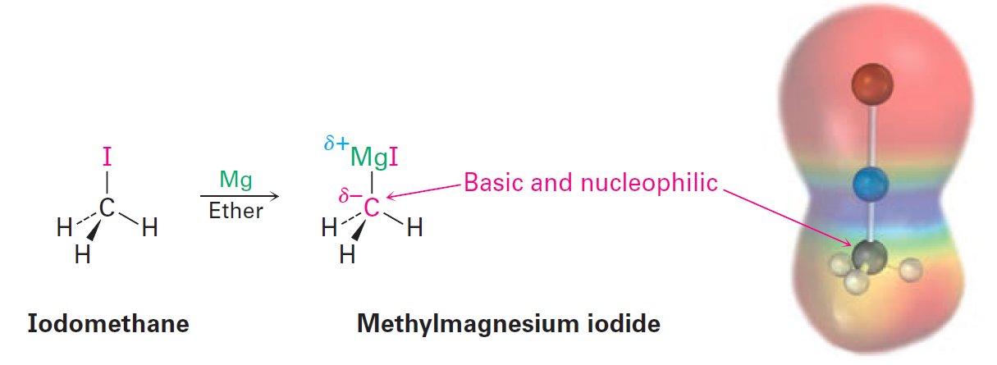
Reactions of Alkyl Halides: Grignard Reagents
Carbon atom of Grignard reagents is both nucleophilic and basophilic
Grignard reagents are formally magnesium salts, R₃C⁻⁺MgX, of a carbon acid, R₃C–H
It is a carbanion
Notes:
Reactions of alkyl halides: Grignard reagents

Slide 32
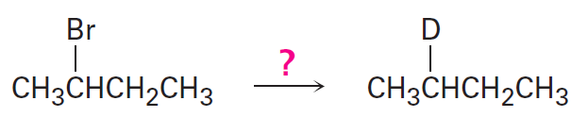
Worked Example
Mention how a halogen substituent can be replaced by a deuterium atom in the preparation of a deuterated compound
Notes:
Reactions of alkyl halides: Grignard reagents

Slide 33
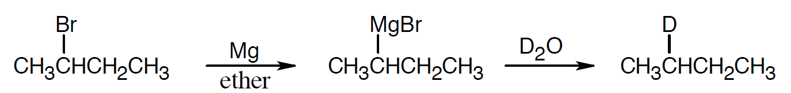
Worked Example
Solution:
In the reaction with deuterium donors, Grignard reagents convert R–MgX into RD
Similar to Grignard reacting with proton donors to convert R–MgX into R–H
Notes:
Reactions of alkyl halides: Grignard reagents

Slide 34
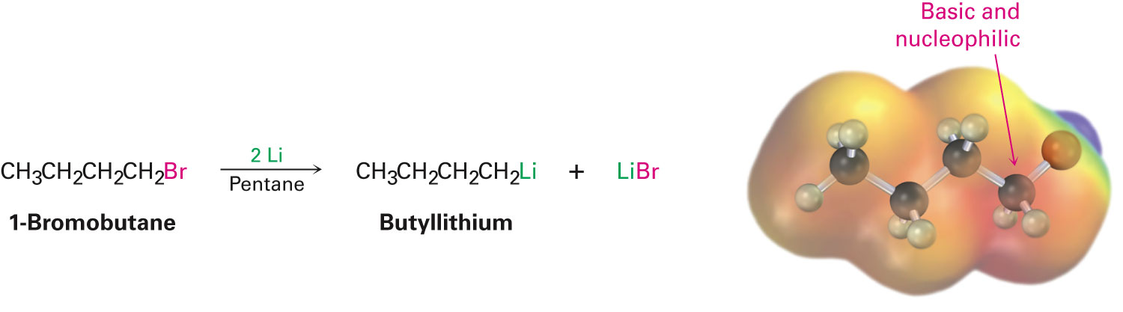
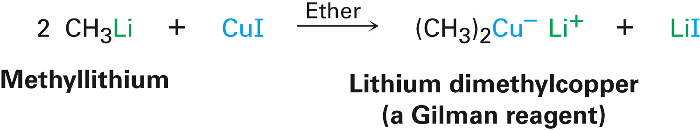
Organometallic Coupling Reactions
Preparation of organometallic compounds is similar to that of Grignard reagents
Lithium metal reacts with alkyl halide to form alkyllithium reagents
Lithium diorganocopper compounds are called Gilman reagents
Notes:
Organometallic coupling reactions

Slide 35
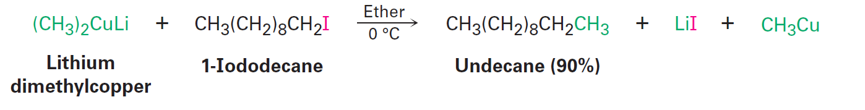
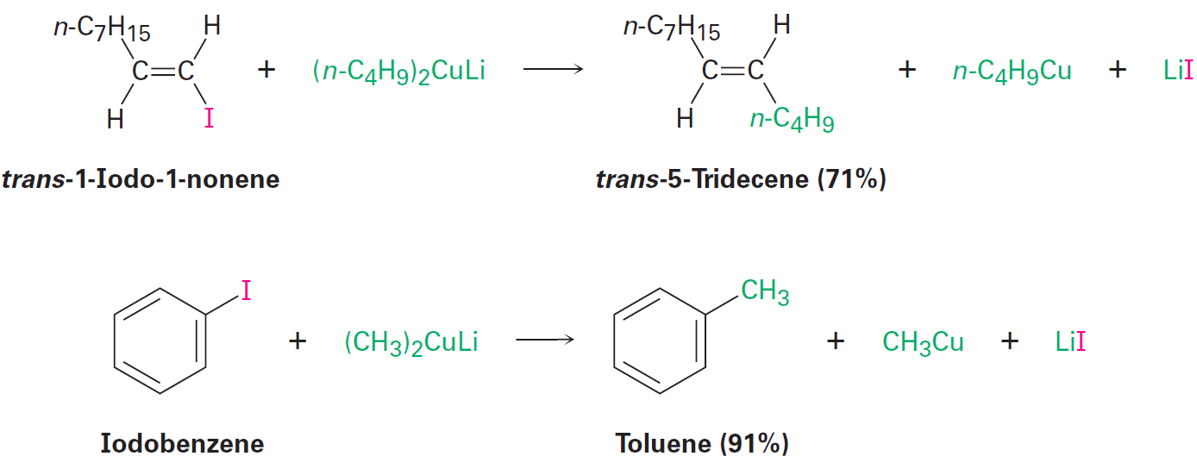
Organometallic Coupling Reactions
Gilman reagents undergo coupling reactions with organochlorides, bromides, and iodides
Coupling reactions from carbon–carbon compounds
Notes:
Organometallic coupling reactions

Slide 36
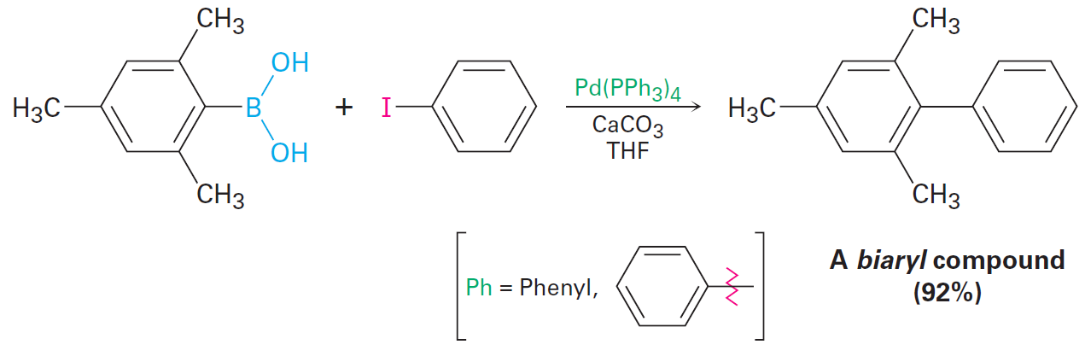
The Suzuki–Miyaura Reaction
Coupling reaction of an aromatic or vinyl substituted boronic acid with an aromatic or vinyl substituted organohalide in the presence of a base and a palladium catalyst
Notes:
Organometallic coupling reactions

Slide 37
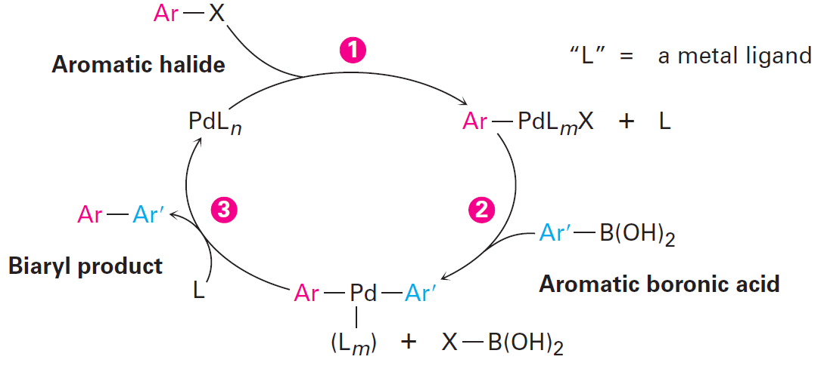
Figure 10.5 - Mechanism of the Suzuki–Miyaura Coupling Reaction
Notes:
Organometallic coupling reactions

Slide 38
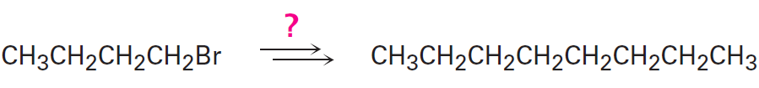
Worked Example
Carry out the following transformation using an organo-copper coupling reaction
Notes:
Organometallic coupling reactions

Slide 39
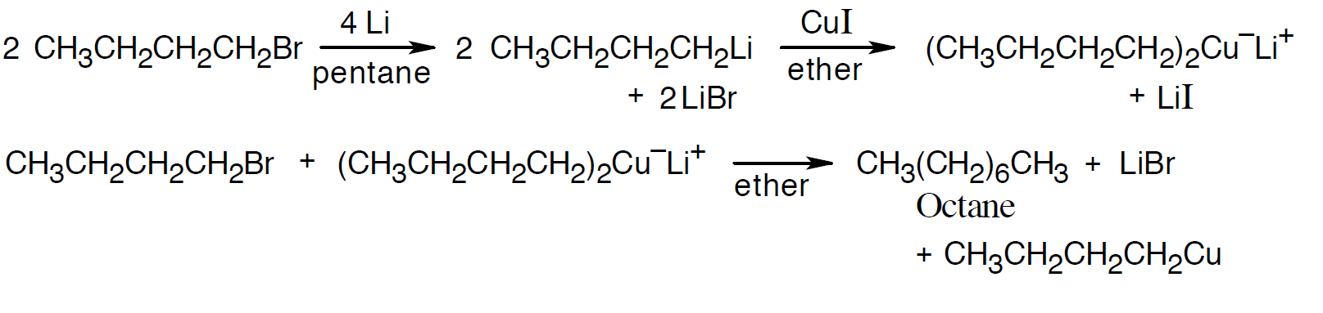
Worked Example
Solution:
Octane is the product of an organometallic coupling reaction between 1-bromobutane and lithium dibutylcopper
1-bromobutane yields the Gilman reagent
Notes:
Organometallic coupling reactions

Slide 40
Oxidation and Reduction in Organic Chemistry
Oxidation decreases electron density on carbon
Forms C–O, C–N, C–X, or breaks C–H
Reduction increases electron density on carbon
Forms C–H (or C–C) or breaks C–O, C–N, C–X
Notes:
Oxidation and reduction in organic chemistry

Slide 41
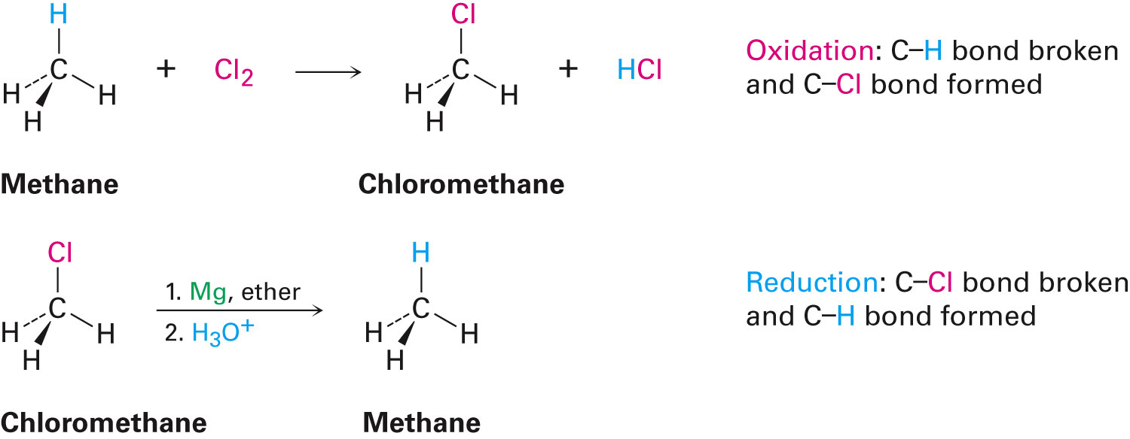
Oxidation & Reduction Reactions
Chlorination reaction of methane is an oxidation
C–CL bond is broken and a C–H bond is formed
Notes:
Oxidation and reduction in organic chemistry

Slide 42
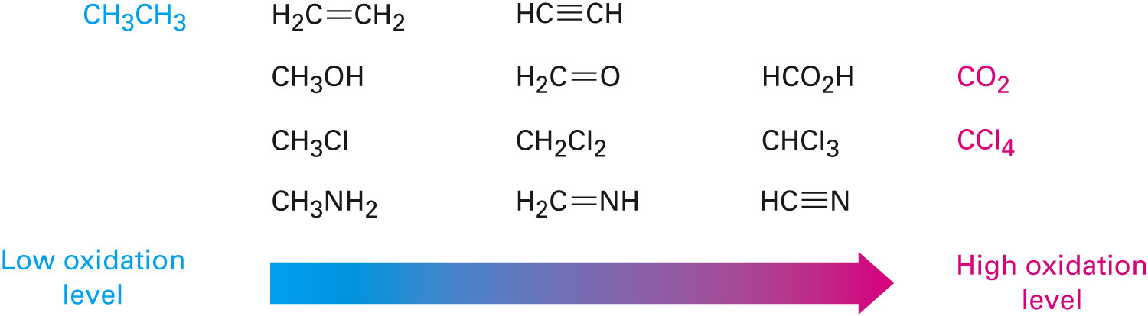
Figure 10.6 - Oxidation Levels of Common Compounds
Alkanes have the highest number of C–H bonds per carbon
CO₂ Has the highest number of C–O bonds per carbon
Notes:
Oxidation and reduction in organic chemistry

Slide 43
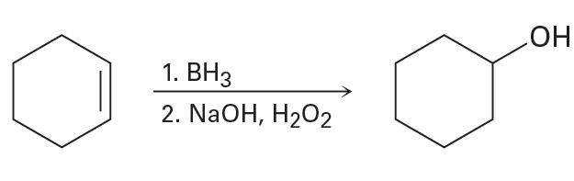
Worked Example
Classify the following reaction as an oxidation, reduction, or neither
Notes:
Oxidation and reduction in organic chemistry

Slide 44
Worked Example
Solution:
It is neither an oxidation nor a reduction
In the double bond:
The oxidation level of the upper carbon changes from 0 to +1 in the product
The oxidation level of the lower carbon changes from 0 to -1
Both the product and the reactant have the same total oxidation level
Notes:
Oxidation and reduction in organic chemistry

Slide 45
Summary
Alkyl halides undergo reactions that are well-studied and are considered very important in the field of organic chemistry
Alkyl halides can be prepared by the reaction of alkenes and N-bromosuccinimide (NBS)
Grignard reagents (RMgX) are formed when alkyl halides react with magnesium in an ether solution
Gilman reagents are formed when alkyl halides react with lithium metal in the presence of copper iodide

